Slide 1
MANAGING A 21ST CENTURY UNIVERSITY: Knowledge, Skills, Quality Assurance and Roles of University Councils and Administrators
Idowu Olayinka
12th Vice-Chancellor
University of Ibadan, Ibadan

Slide 2
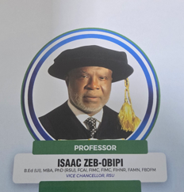
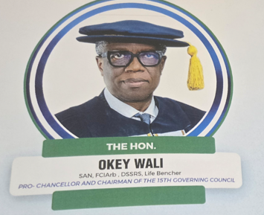
Acknowledgements

Slide 3
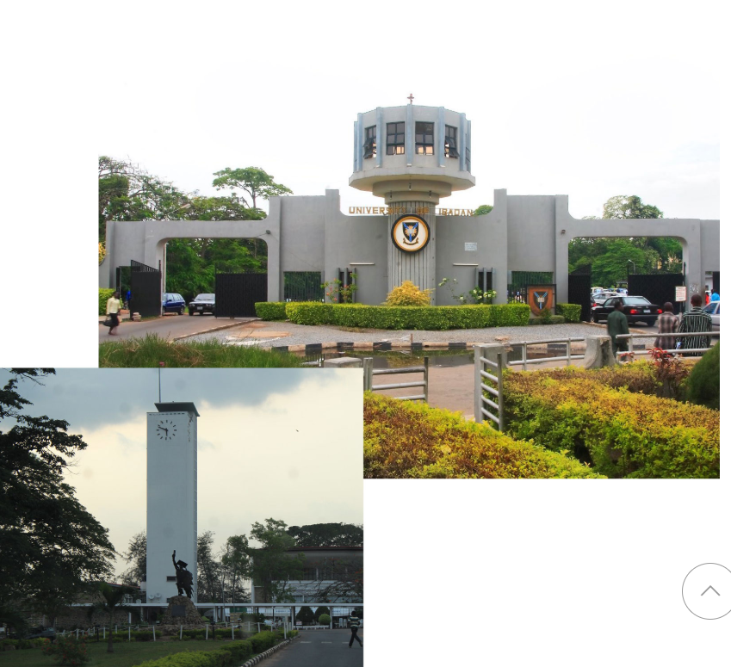

Greetings from the University of Ibadan

Slide 4
Theme of This Retreat
A New Strategic Direction to Inspire and Reposition the Rivers State University for Excellence and Creativity

Slide 5
Outline
Characteristics of Universities
Strategic Leadership
Governance Structure
Common Strategic Objectives for Universities
Checklist for a 21st Century-Compliant University
Components of a Sound Strategy Document
Conclusion

Slide 6
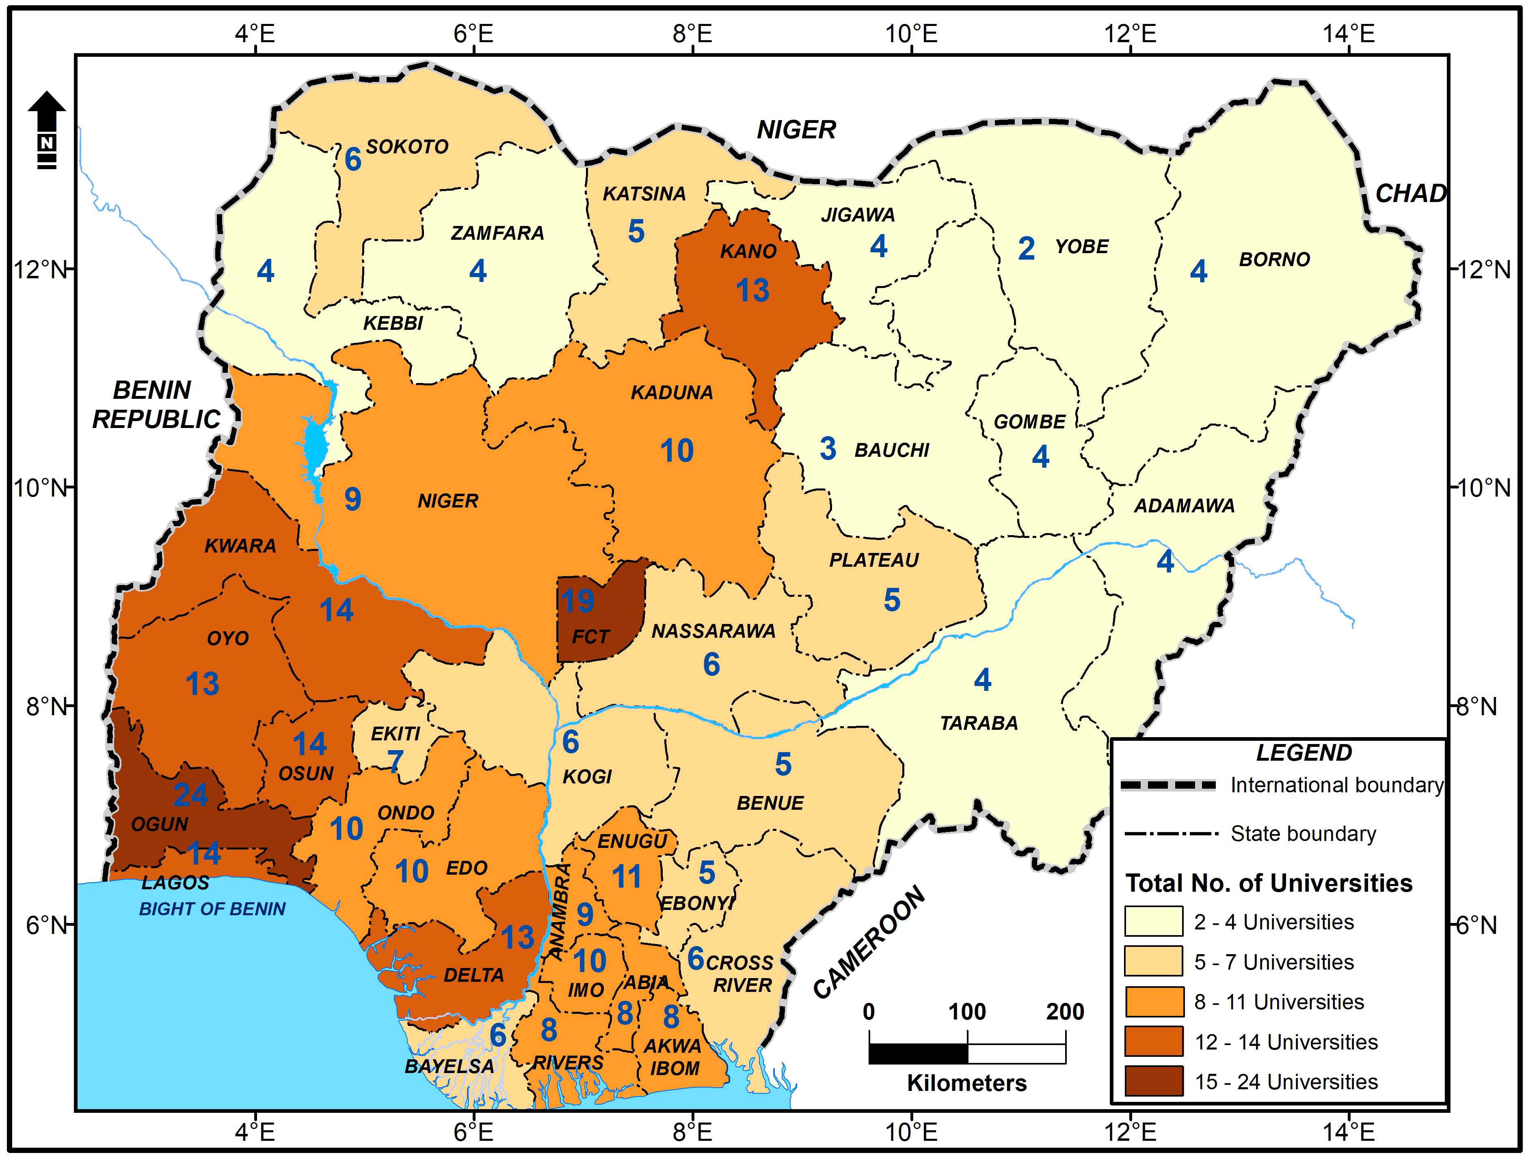
Figure: Geographical distribution of Total Number of Universities in Nigeria as at April 2026 (Source of data: https://www.nuc.edu.ng) TOTAL = 311 UNIVERSITIES
Federal Universities 75
State Universities: 67
Private Universities: 168
TOTAL=311 UNIVERSITIES.
Inevitably, this leads to intense competition for Faculty, Students and financial resources.

Slide 7

Kenneth Mellanby (1908-1993):
The First Principal of University College Ibadan 1947-1953
The provision of teaching for our students and the prosecution of original research by our staff were our most important duties.
Mellanby, K., 1958. The Birth of Nigeria’s University. London: Methuen.

Slide 8
To be relevant in this 21st Century, Nigerian Universities must -
Teach the next generation – with up-to-date facilities on real market questions about the sciences needed to address current and future questions.
Conduct research - “Curiosity-driven Research,” certainly but– the University also needs to bring Science to bear on social problems and industry needs.
Commercialize – New science-led solutions to societal problems, new products, processes.
Generate market-ready students – Create a cadre of creative and curious team players.

Slide 9
Strategic Management…
Requires a strategic plan
Encompasses strategic planning
But is much more than that…

Slide 10
Why does Rivers State University needs a strategy?
An agreed statement of purpose and direction.
A reference point against which management and operational decisions can be taken.
A framework within which activity can be directed, led or encouraged (action plans, projects, initiatives, use of resources).

Slide 11
Why does Rivers State University needs a strategy?...contd.
For communication and promotion (internal and external).
To help meet accountability requirements.

Slide 12
Who are the major stakeholders in RSU?
(i). Proprietor: The Rivers State Government; The State House of Assembly;
(ii). Funding agencies, regulatory bodies, and policymakers including Tertiary Education Trust Fund (TETFund); Auditor-General, Accountant General, FME, NUC, JAMB, NELFUND, etc.
(iii). Faculty and Staff: Professors, lecturers, administrators, and support staff.
(iv). Students: Those enrolled in academic programmes.
(v). Alumni: Graduates who can influence the university's reputation.

Slide 13
(vi). Parents and Guardians: They financially support the students.
(vii). Local Community: Neighbours and residents impacted by the university.
(viii). Donors and Sponsors: Individuals or organizations providing financial support.
(ix). Employers: Companies and organizations hiring graduates.
(x). Staff Unions (ASUU, SSANU, NAAT, NASU)
(xi). Industry/The Private Sector

Slide 14
Leadership & Management
The leader is a dreamer, envisioning, setting the direction, creating the environment for change and effecting it, spotting new opportunities, and charting uncharted paths.
Leadership is equated with dynamism, vibrancy and charisma.

Slide 15
Workspace for Managers and Leaders
manage the vision and dreams of
the institution, and
set the agenda for development
Leaders
Managers
Administrators
manage people and rules
manage rules, regulations and protocols

Slide 16
Governance Structure in Nigerian Public Universities

Slide 17
Section 2. (1) of the University of Ibadan Act 1962 (as amended) states that………..The University shall consist of –
a Chancellor;
a Pro-Chancellor and a Council
a Vice-Chancellor and a Senate
a body to be called Congregation;
a body to be called Convocation;

Slide 18
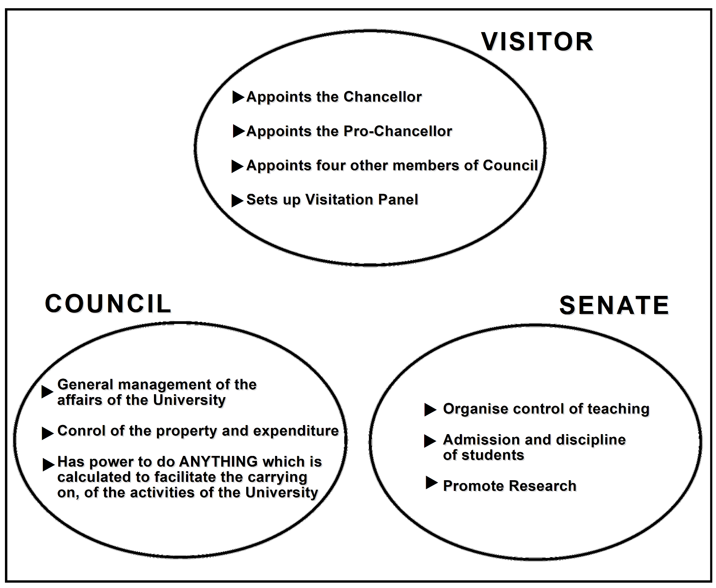
Fig: Schematic relationship between Visitor, Council and Senate

Slide 19
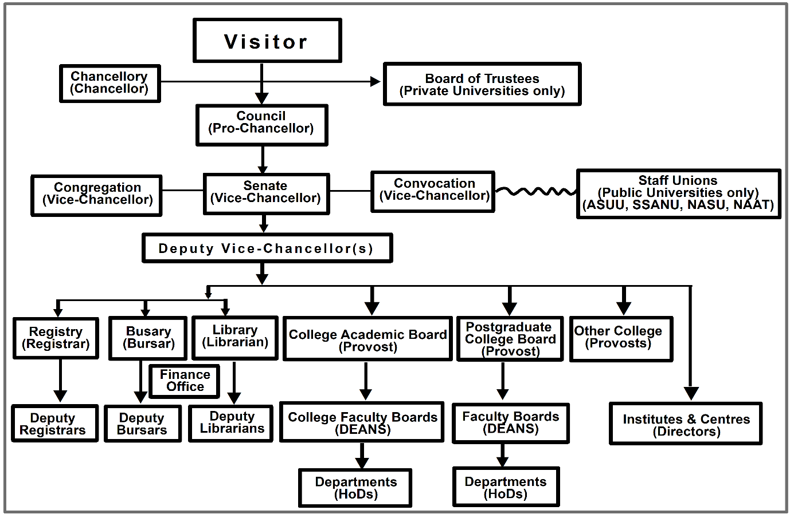
Figure: Typical Governance Structure in Nigerian Universities

Slide 20
Fig: Schematic representation of Membership of Council & Senate in Federal Universities
PRO-CHANCELLOR & CHAIRMAN
VICE-CHANCELLOR
COUNCIL
SENATE
VC
DVCs
Profs.
4 Appointees of Visitor
Deans
Rep of Fed Min Educ.
Deputy VCs
2 Rep. of Congregation
4 Reps of Senate
HoDs
Directors
1 Rep of Convocation
Registrar/Secretary
Registrar/Secretary

Slide 21
Subject to the provisions of this Act relating to the Visitor,
the Council shall be the governing body of the university
and shall have the general management of the affairs of the university and in particular the control of the property and expenditure of the university.

Slide 22
Subject to subsection (6) of this section, the Council shall have power to do anything which in its opinion is calculated to facilitate the carrying on of the activities of the University.

Slide 23
The Council shall not have power to dispose of or charge any lands or an interest in any lands (including any lands transferred to the university by this Act) which are held by or on behalf of the university except with the prior, written consent, either general or special, of the Minister.

Slide 24
There shall be a committee of the council, to be known as the Finance and General Purposes Committee, which shall, subject to the directions of the council, exercise control over the property and expenditure of the university.

Slide 25
Senate
It shall be the general function of the senate to organize and control the teaching at the university and the admission and discipline of students and to promote research at the university.

Slide 26
(2) Without prejudice to the generality of the foregoing subsection and subject as there mentioned, it shall in particular be the function of the Senate to make provision for -
the establishment, organization and control of faculties and other departments of the university, and the allocation to different departments of responsibility for different branches of learning;

Slide 27
the appointment and promotion of teachers at the university;
the organization and control of courses of study at the university and of the examinations held in conjunction with those courses;

Slide 28
the award of degrees, and such other qualifications as may be prescribed, in connection with examinations held as aforesaid;
the making of recommendations to the council with respect to the award to any person of an honorary fellowship or honorary degree or the title of professor emeritus;

Slide 29
the selection of persons for admission as students at the university;
the establishment, organization and control of halls of residence and similar institutions at the university;
the supervision of the welfare of students at the university and the regulation of their conduct;
the grant of fellowships, scholarships, prize and similar awards, in so far as the awards are within the control of the university; and
ii. determining what descriptions of dress shall be academic dress for the purposes of the university, and regulating the use of academic dress.

Slide 30
(3) The Senate may make regulations for the purpose of exercising any function conferred on it either by the foregoing provisions of this section or otherwise.
(4) Regulations shall provide that at least one of the persons appointed as the examiners at each examination held in conjunction with any course of study at the university is not a teacher at the university but is a teacher of the branch of learning to which the course relates at some other university of high repute,
(5) Any department established for the university and designed by regulations as a Faculty of the university shall be organized in accordance with the provisions of the Third Schedule to this Act.

Slide 31
Between 50% and 64% of the total membership of the Council double as members of the University Senate.
Quality of work and commitment to excellence by university senates largely determine the visibility, respect, acceptance and relevance that universities receive including ranking among their peers.

Slide 32
Universities place strong emphasis on operations of their Senates.

Slide 33
What are Academics employed to do?
(i). Teaching and Learning — to produce skilled graduates;
(ii). Research — to expand the frontiers of knowledge;
(iii). Community Service — to apply expertise to societal needs.

Slide 34

Which University in the World Has Produced the Most Nobel Laureates?
The Nobel Prize has been the pinnacle of human intelligence, creativity, and worldwide influence for many years.

Slide 35
Harvard University cultivates an ecosystem in which interdisciplinary cooperation, research, and intellectual freedom come together to develop and produce ideas that change the course of humanity.
Harvard University has produced more than 155 Nobel laureates, thus making it the university with the most Nobel laureates worldwide.

Slide 36

Why Harvard remains at the top

Slide 37
According to James Bryan Conant, the 23rd President of Harvard University:
There is only one proved method of assisting the advancement of pure science – that is picking men of genius, backing them heavily and leaving them to direct themselves.

Slide 38
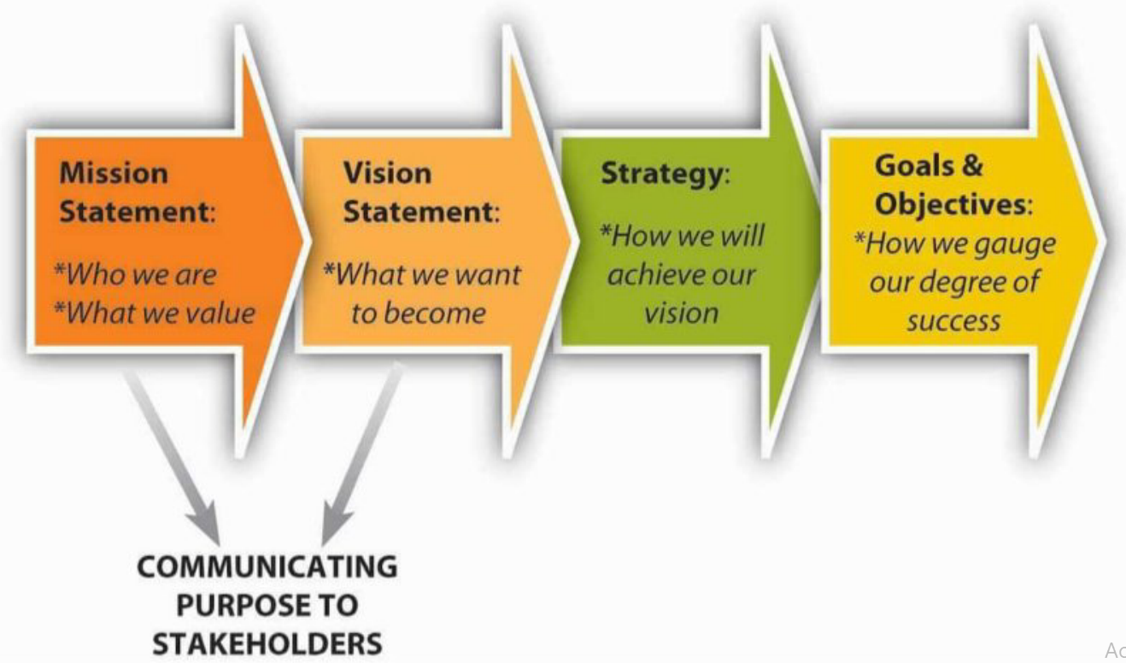
Figure: Strategic Leadership

Slide 39
Common Strategic Objectives for Universities
Academic Excellence: Improving student outcomes, enhancing academic programs, and increasing research productivity.
Student Success: Enhancing student engagement, retention, and graduation rates.

Slide 40
Diversity, Equity, and Inclusion: Fostering a diverse and inclusive community, promoting equity, and addressing systemic barriers.
Community Engagement: Building partnerships with local communities, industries, and organizations to drive economic growth and social impact.
Sustainability: Reducing the university's environmental footprint, promoting sustainable practices, and ensuring long-term financial viability.

Slide 41
Developing institutional research strategies
What is strategic management?
Relationship to the complex, ever-changing, ever more challenging, policy and operating environment

Slide 42
Approaches to strategy development
Corporate approach
  Top-down, Definitional, Directive…
Emergent approach
  Bottom-up, Opportunistic, Inquisitive…
Participative approach
  Challenging dialogue, Inclusive, Engaging…
What are the potential benefits and/or disadvantages of each of these?

Slide 43
Strategic Planning Cycle
Actions
Priorities
Time lines
Resources
Milestones
Monitoring
Operational
planning
Define
Vision/Mission
Objectives
Starting out
Situation
analysis
SWOT

Slide 44
Integrated Planning
Organization
Strategic Plan
Center
Strategic Plan
Faculty
Strategic Plan
Department
Strategic Plan

Slide 45
Where to start: the vision
e.g. For RSU, Port Harcourt, to become a top 10 University in Africa.

Slide 46
Where are we now?
Analysis and Benchmarking
Performance, resources and sustainability
Measures of success
Reality checking
Knowing your own strengths
Realising your potential
The policy and operating environment

Slide 47
Who cares?
A market-led approach
The markets for your intellectual assets:
  academic peers
  practitioners
  policy makers
  industry and commerce

Slide 48
So what’s the strategy?
Where do we want to be?
What do we need to do to get there from where we are now?
How are we going to do it?
How will we know if we’re going in the right direction, and if we have arrived?
Vision
Objectives
Implementation Plan
Performance Measures

Slide 49
Strategic Management is…
…the process of asking and answering these questions every day
Taking actions which are consistent with, and supportive of, achieving the strategy
Pursuing the implementation plan
Measuring performance and reviewing action

Slide 50
Continuous Process
Assessment
Planning
Action

Slide 51
Whose job is it anyway?
Senior Management?
Academic leaders?
Administrative managers?
The Planning Office?
The Research Office?
Individual researchers?

Slide 52
Strategic management and the policy environment
“Strategic management consists of the analysis, decisions, and actions an organization undertakes in order to create and sustain competitive advantages… Strategic analysis [is the] starting point in the process and precedes effective formulation and implementation of strategies.”
Dess, Lumpkin & Taylor; Strategic Management: Creating Competitive Advantage; McGraw-Hill 2005, 1.1; 1.3

Slide 53
The Policy Environment
Understanding, and interpreting the implications of, the policy environment is part of the process of strategic analysis.
No organisation can operate effectively in ignorance of the environment in which it sits
It is exceptionally difficult to achieve objectives against the direction of the main policy drivers
But it is important not simply to be driven by the environment

Slide 54
Reading the “policy landscape”
Is a key part of strategic management
Is an ongoing task
Is one of the key ways in which senior managers can add value
Can provide opportunities to shape the landscape

Slide 55
Components of a Sound Strategy Document
1. Executive Summary. A concise overview of the strategy, highlighting goals, priorities and expected impact.
2. Vision, Mission and Core Values. Clearly articulates the long-term aspiration (vision), purpose (mission), and values guiding the institution.
3. Strategic Context and Situational Analysis: Includes SWOT, PESTELI, stakeholder mapping and summary of the internal and external environment.

Slide 56
4. Strategic Priorities/Pillars. Three to five focus areas that align with the institution’s mission and future direction.
5. Strategic Objectives and Goals. SMART goals under each priority, organised by short-, medium- and long-term timelines.
6. Initiatives and Key Actions. Concrete Projects and Programmes to advance each goal with timelines and responsibilities.

Slide 57
7. Performance Metrics/Key Performance Indicators. Measure of success to track progress, including targets and benchmarks.
8. Implementation Plan and Roadmap. Detailed Timelines of Initiatives, Milestones and Owners from launch to end date.
9. Governance and Accountability. Defines Decision-Making Processes, Leadership Roles and Oversight Responsibilities.

Slide 58
10. Risk Assessment and Mitigation. Identification of Major Risks and Strategies to Mitigate them.
11. Resource Plan. Outlines Financial Needs, Staffing, Partnerships and Other Resources Required.

Slide 59
12. Communication and Change Management. Plan for Internal/External Communication, Stakeholder Engagement and Change Adoption.
13. Monitoring, Evaluation and Learning. Framework for Tracking, Reviewing and refining the Strategy over time.

Slide 60
Quality Assurance in University Education
Refers to the systematic processes designed to ensure that educational provision meets established standards and continuously improves.
In education, QA ensures that institutions deliver relevant, effective, and credible learning experiences.
In Nigeria, the main regulatory body is the National Universities Commission and various professional bodies.

Slide 61
Typical areas covered in QA
Curriculum design and review
Teaching and learning processes
Assessment and evaluation
Staff qualifications and development
Learning resources and infrastructure
Student support services

Slide 62
Core Elements of Quality Assurance are standards (benchmarks), processes (policies and procedures), monitoring and evaluation (continuous review), as well as feedback and improvement (corrective actions). QA focuses not only on outcomes but also on the processes that lead to those outcomes.
Integrating student-centred learning into QA processes offers an opportunity to refocus quality assurance on actual learning outcomes and student development.

Slide 63
Student-centred Learning as a Quality Assurance Strategy
Student-centred learning directly contributes to quality assurance by improving the effectiveness, relevance, and inclusiveness of teaching and learning.
When students are actively engaged, learning outcomes are more likely to be achieved, monitored, and improved.
Student-centred learning represents a deliberate shift from traditional, content-heavy, teacher-dominated instruction to pedagogies that emphasize active engagement, critical inquiry, collaboration, and learner autonomy.

Slide 64
Quality Assurance (QA) in 21st-century universities
involves several key elements that ensure institutions meet high standards of education, research, and community engagement. Here are some of the essential components:
Institutional Accreditation: Evaluations and accreditation processes conducted by independent bodies to measure compliance with national and international standards.
Program Accreditation: Documents the quality and compliance of a particular educational program with national or international standards.

Slide 65
Internal Quality Assurance (IQA): A systematic approach to ensuring quality, involving self-assessment, monitoring, and continuous improvement.
At the University of Ibadan, there is a Director of Quality Assurance.
Moreover, there is a Standing Committee on Mock Accreditation

Slide 66
External Quality Assurance (EQA): Involves external evaluations, audits, and accreditation to ensure institutions meet established standards.
Strategic Planning: Aligns quality assurance with the university's mission, vision, and objectives.
Data Management and Evidence-Based Decision Making: Collects, analyzes, and uses data to inform decision-making and drive improvement.

Slide 67
Stakeholder Engagement: Involves students, faculty, and external stakeholders in quality assurance processes.
Technology Integration: Incorporates digital tools, AI, and big data analytics to enhance quality assurance efficiency and effectiveness.
Industry Collaboration: Strengthens partnerships with industries to ensure programs meet industry needs.
Research, Development, and Entrepreneurship: Manages research and innovation processes within the framework of quality assurance.

Slide 68
These elements help universities maintain academic excellence, achieve sustainable development, and strengthen their international presence.

Slide 69
Knowledge and Academic Excellence in a 21st-century University
Interdisciplinary Approach: Fostering collaboration across departments to tackle complex challenges like climate change, healthcare disparities, and urban development.
Critical Thinking and Problem-Solving: Nurturing skills that empower students to adapt and thrive in a rapidly changing world.

Slide 70
Digital Literacy: Embracing technology to enhance learning, research, and innovation.
Global Competence: Developing students' understanding of global issues, cultural diversity, and international cooperation.

Slide 71
Lifelong Learning: Encouraging students to become self-directed learners, adaptable to new challenges and technologies.
Social and Emotional Learning: Cultivating self-awareness, empathy, and healthy coping mechanisms to navigate modern complexities.

Slide 72
Industry Collaboration: Partnering with industries to leverage resources, expertise, and networks in addressing societal challenges.
Innovation and Entrepreneurship: Providing resources and mentorship for students to develop creative solutions and turn ideas into successful ventures.

Slide 73
Research-Based Practices: Grounding teaching and learning strategies in evidence-based research.
Culturally-Competent Leadership: Empowering faculty mmbers to become leaders in learning, adaptable to diverse cultural contexts.
These elements help universities maintain academic excellence, achieve sustainable development, and strengthen their international presence.

Slide 74
Skills development in a 21st-century university involves several key elements
Digital Literacy: The ability to critically evaluate, create, and communicate digital content, as well as navigate online spaces safely and effectively.
Critical Thinking and Problem-Solving: Developing skills to think critically about digital tools and information, and solve problems using technology.

Slide 75
Collaboration and Communication: Working effectively with others using digital tools, and communicating respectfully in online environments.
Information Literacy: Locating, evaluating, and using information from digital sources, while understanding ethical and legal issues.

Slide 76
Content Creation: Creating digital content such as videos, blogs, and presentations, using digital tools to express ideas and share information.
Digital Citizenship: Understanding online safety, digital etiquette, and managing one's online presence.
Creativity and Innovation: Using digital tools to develop creative solutions and express ideas.
Career Readiness: Preparing students for jobs requiring digital literacy skills

Slide 77
Present Reality in the Nigerian University System
A general complaint about the poor quality of service rendered to our various publics, including staff, students, alumni/alumnae and visitors.
Some of the factors affecting quality of service and effective operations include the following:
Lack of self-motivation;

Slide 78
Lack of knowledge of work process/procedures;
Absence of continuous coaching and mentoring by superiors;
Pervading decline in work/service culture;
Irregular in-service training and staff development;
Limited proper orientation for new staff;
Low computer and IT skills;

Slide 79
Lack of enabling and conducive environment;
Continued use of the outdated manual system of documentation and record management;
Poor Quality Control and Quality Assurance of Registry and Bursary staff;
Inability to manage change;
Ineffective leadership and governance; and
Challenges with staffing (recruitment, training retention, maintenance of acceptable administrative culture).

Slide 80

Tekena N. Tamuno (1932-2015) at his last Convocation Speech as the VC of UI in 1979…
" All things bright and beautiful
All things great and small
NIGERIANS DESTROY THEM ALL“
This was a modification of the hymn by Mrs Cecil Alexander published in 1848.

Slide 81
Concluding Remarks
“Managing strategy is arguably the most important thing a university does, enabling all of its core activities…to be optimally achieved. It involves a thorough knowledge of the institution’s present strengths and weaknesses and the making of choices about the future.

Slide 82
Good analysis and intelligent choices will ensure the exploitation of opportunities, the avoidance of disaster and improved reputational positioning.
A sound, well expressed strategy will encapsulate the institution’s self-identity, gather business and win friends.”
Watson, D; Managing Strategy, Open UP 2000, 1

Slide 83
University-Industry Collaboration Infrastructure (TRIPLE HELIX MODEL)
Universities and
R&D institutions
  Intellectual Property Policy
  Intellectual Property Committee
  Tech Transfer Office
IP Assets
Government
Economic Development (SME Policies, market creation
National IP Infrastructure (Laws and Regulations)
Enforcement
IP Strategy
R&D Enhancement
IP Education
Research Funds
Industry
Research Funds
Research Collaborations
Licensing
Marketing
Production and Commercialization
© 2009 Yumiko Hamano

Slide 84
Setting an Agenda for the Rivers State University is an excellent way to chart a future for the institution.
A faithful implementation of the action points with a buying-in by all the stakeholders would lead to the achievement of the lofty goals being developed.

Slide 85
I THANK YOU ALL FOR YOUR VERY KIND ATTENTION

