Slide 1

Fundraising and Investment Strategies for University Advancement
Prof. Victor S. Dugga, PhD
MNAL, AvHF, fsonta
Presented at the Retreat The Governing Council,
Rivers State University, 9th April 2026

Slide 2
In this Presentation…
The New Reality of Higher Education Finance
Fundraising
Investment Strategy Overview
Integrating Fundraising & Investments
Emerging Trends and Innovations

Slide 3
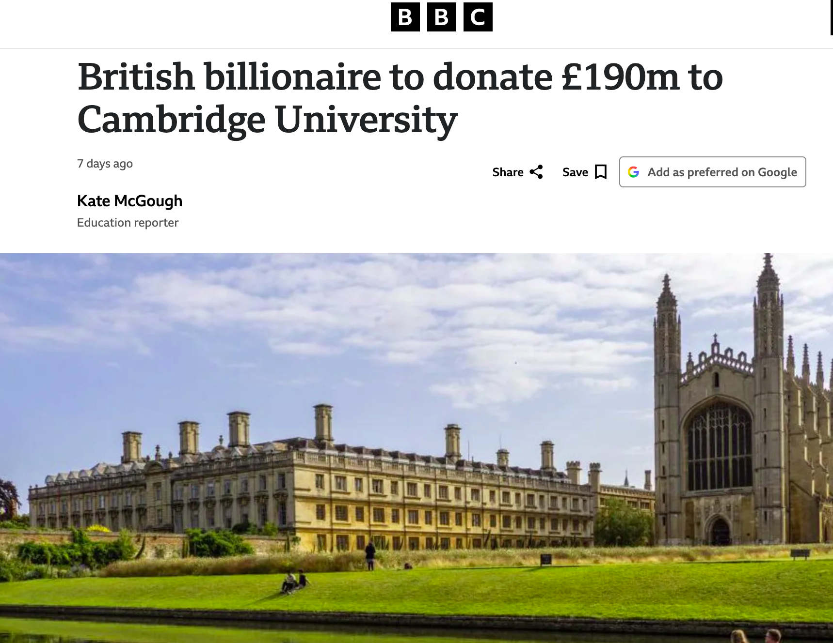
Billionaire hedge fund owner Chris Rokos is to donate £190m to the University of Cambridge. He attended Oxford University!
“The largest single donation made to a British university in modern times".
To create a school of government in Cambridge named after him.
He won a scholarship to Eton College after attending a state primary school, and studied mathematics at Pembroke College, Oxford.
Dr Elisabeth Kendall, President of Girton College, Cambrdge University, was friends with Rokos when they were undergraduates together in Oxford!

Slide 4
The Strategic Context
Increasing demographic pools of students
Rising operational costs (salaries, facilities, technology)
Volatility in tuition-dependent revenue models
Increasing demand for student financial aid
Global rankings and competitiveness

Slide 5


Securing the Future: Fundraising and Investment Strategies for University Advancement
Fundraising
Investment
Current fundraising (immediate impact)
Endowment investment (perpetual sustainability) - growing a tree

Slide 7
What is Fundraising?
Seeking additional external resources to develop specific projects or to provide general support to the institution
The process of soliciting and gathering voluntary contributions of money and other resources, by requesting donations from individual, businesses, charitable foundations or governmental agencies

Slide 8
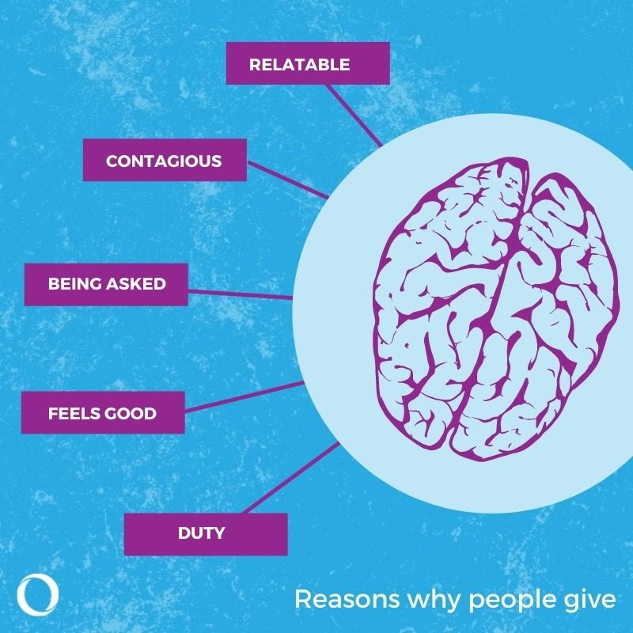
Why do people give?
8 Reasons for giving:
i. Awareness of need;
ii. Solicitation;
iii. Costs and benefits;
iv. Altruism;
v. Reputation;
vi. Psychological benefits;
vii. Values;
viii. Efficacy.

Slide 9
Principles of Fundraising
People give to people they know/trust/care about
People who gave before are likely to give again if they are satisfied with the outcome of their earlier gift
Gifts are to be used and transparently accounted for

Slide 10
Cultivation Cycle

Slide 11
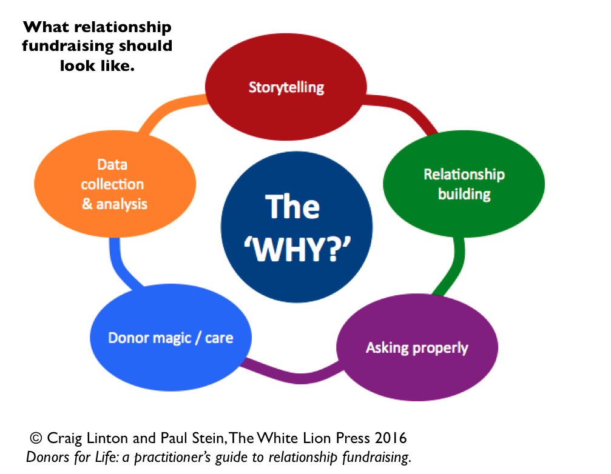

Slide 12
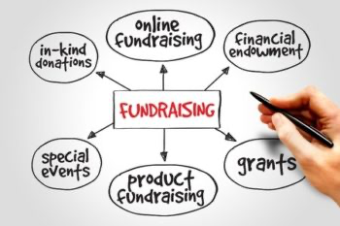
Types of Fundraising

Slide 13
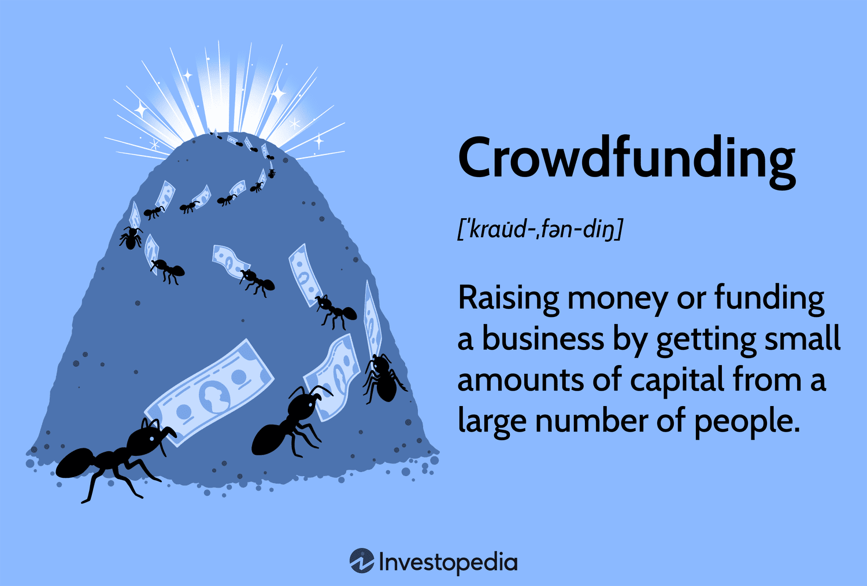
Popular sites:
Kickstarter, Indiegogo, and GoFundMe

Slide 15
Annual Giving
- Unrestricted, immediate-use gifts
- Focus: Participation rate, recurring giving programmes
- Metric: Donor retention (70%+ is excellence)

Slide 16
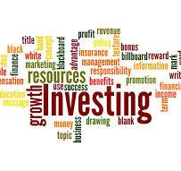

Investment in Higher Education Management

Slide 17
The Endowment Model
What is an Endowment?
- A permanent, self-sustaining fund
- Principal is preserved; only a portion of earnings is spent annually.
- Pooled investment structure
- Diversified asset allocation
- Long-term time horizon (perpetuity)

Slide 18
Endowment Spending Policy
- Typically 4–5% of trailing 12-quarter average market value
- Smooths spending volatility during market fluctuations
- Protects intergenerational equity

Slide 19
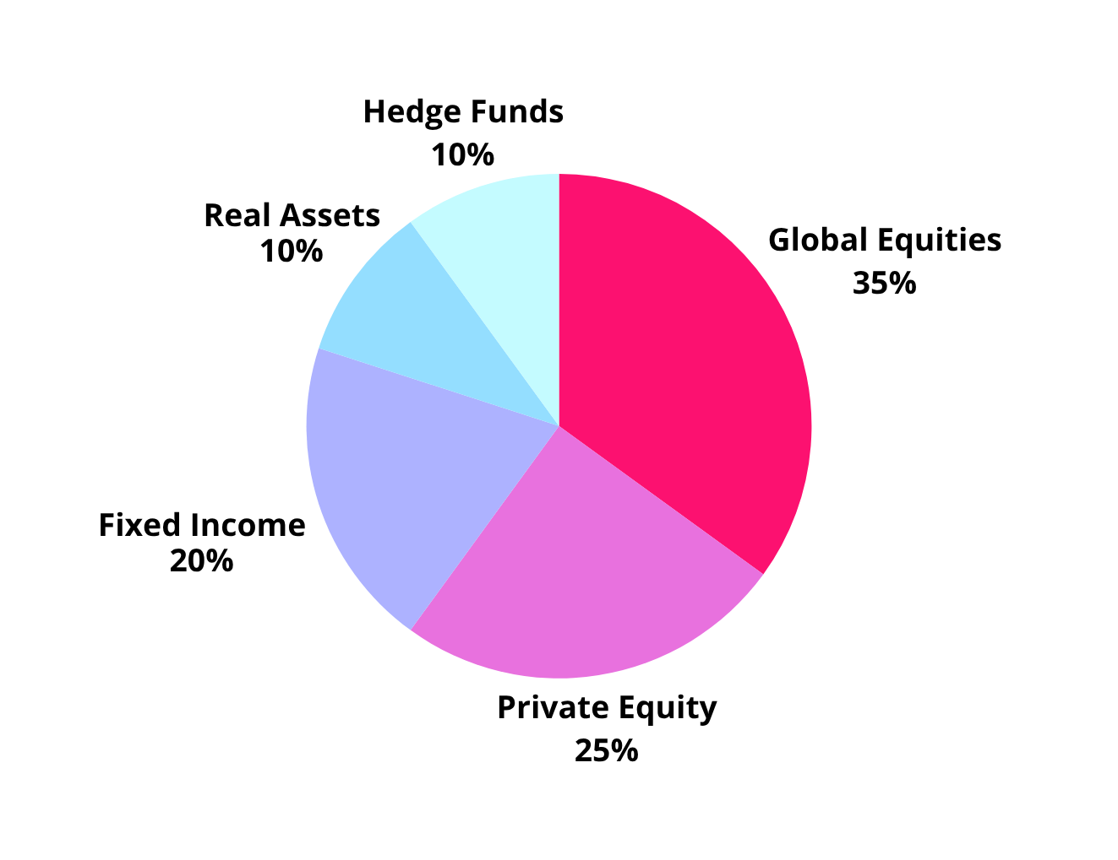
Diversified Investment Asset Allocation Framework

Slide 20
Governance Structure
Board of Trustees
↓
Investment Committee (Trustees + External Experts)
↓
Chief Investment Officer (CIO) / Investment Office
↓
External Managers (Public Markets, Private Equity, Real Estate, etc.)

Slide 21
Key Risks and Mitigation
Market Volatility - Donor reluctance during downturns.
Endowment value declines - Diversified portfolio.
Reputational Crisis - Donor withholding- Strong stewardship; crisis communication.
Donor Fatigue - Declining participation, stewardship.
Inflation - Larger gift requests needed.
Regulatory - Tax law changes; planned giving emphasis.

Slide 22
Emerging Trends and Innovations
Fundraising Trends:
- AI and Predictive Analytics: Identifying prospects earlier, personalizing engagement
- Digital Fundraising: Peer-to-peer, virtual events, cryptocurrency gifts.
- Impact Investing Alignment: Donors increasingly interested in gifts that align with their values (ESG, climate, social justice)
- Donor-Advised Funds (DAFs): Fastest-growing giving vehicle; requires strategic engagement.

Slide 23
Emerging Trends and Innovations
Investment Trends:
-ESG Integration: Environmental, social, governance factors in manager selection
- Direct Investing: Larger endowments investing directly in private companies (bypassing fund fees)
-Liquidity Management: Balancing illiquid allocations with operational liquidity needs
- Outsourced Chief Investment Officer (OCIO): Access to specialized expertise, increased operational efficiency, and enhanced risk management.

Slide 24
Conclusion
Fundraising fuels the present; investment secures the future. The most resilient universities manage both as an integrated capital strategy, not separate functions.
Continuous engagement with the broader community as volunteers, donors, etc.
Optimizing management skills.

Slide 25
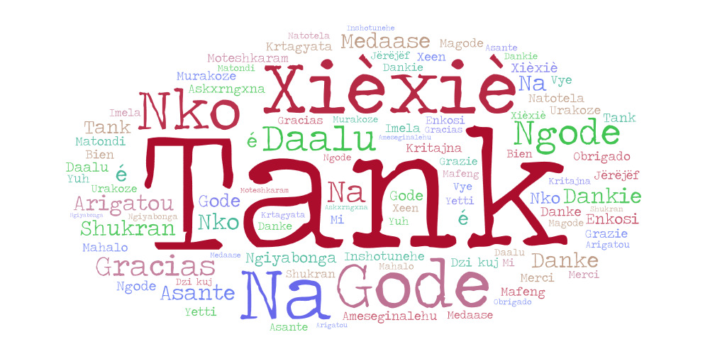
svdugga@gmail.com

